Slide 1
Welcome

Slide 2
Information Website www.brookfieldsschool.com
School day starts at 9.00am-3.15pm. If you are dropping your children off the school doors will not be open until these times.
First day bring nappies and wipes (if applicable).
Spare clothes to be kept at school. Please ensure names are in everything even shoes, coats, hats and scarfs. EVERYTHING!
For a school bag use a ruck sack rather than book bag, this holds everything and promotes independence (they can carry it themselves).

Slide 3
What you will need for Swimming and PE swimming: towel swim nappy trunks/costume(please ensure they all have names in) PE: Nothing

Slide 4
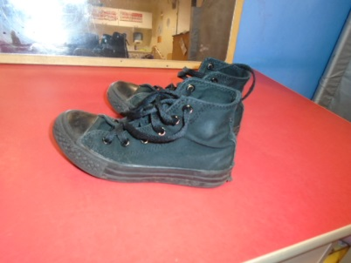
Uniform
Red jumper or cardigan (do not need to have logo).
White shirt/polo shirt.
Grey skirt or trousers/shorts
If your child takes off their shoes please
consider high top shoes\boots.
Jumpers and polo shirts can be ordered from school or you
can get them from supermarkets.
Please contact school to place the orders if required.
We will get messy as the Early Years curriculum encourages
lots of exploration and investigation indoor and outdoors.

Slide 5
If your child is sick please call the office. Even if your children come on the bus you must call the office and not pass a message via the bus guide.
We can not give calpol/paracetamol.
Only prescribed medication. Form to be completed, you can download a copy from the website.
We will provide you with a home/school
book. Please write in to let us know any useful
information i.e not slept well, not had breakfast or
any lovely things you have been doing. We will let
you know about the school day.

Slide 6
Lunch and Snack Early Years children get free school meals. children on packed lunch will also have access to a school dinner. Snack is £2.00 per week(pay per term PAYMENTS TO BE MADE ELECTRONIC NO CASH) please see our website or contact school for information on how to do this.

Slide 7
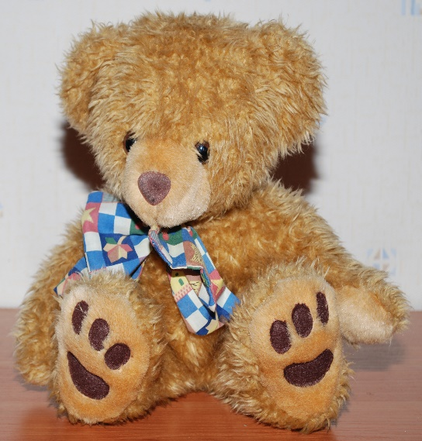
Toys from home.
We understand some children may require some toys/items as a comforter. If possible try to discourage them from bringing their favourite toys as it can be difficult for the teaching teams to ensure they go home.

Slide 8
Early Years Curriculum
Development Matters in the Early Years Foundation Stage (EYFS) This non-statutory guidance material supports practitioners in implementing the statutory requirements of the EYFS.
We will send a copy home during the first week. We would like you to highlight what your child can already do, and send it back to us. This will give us some baseline information.

Slide 9
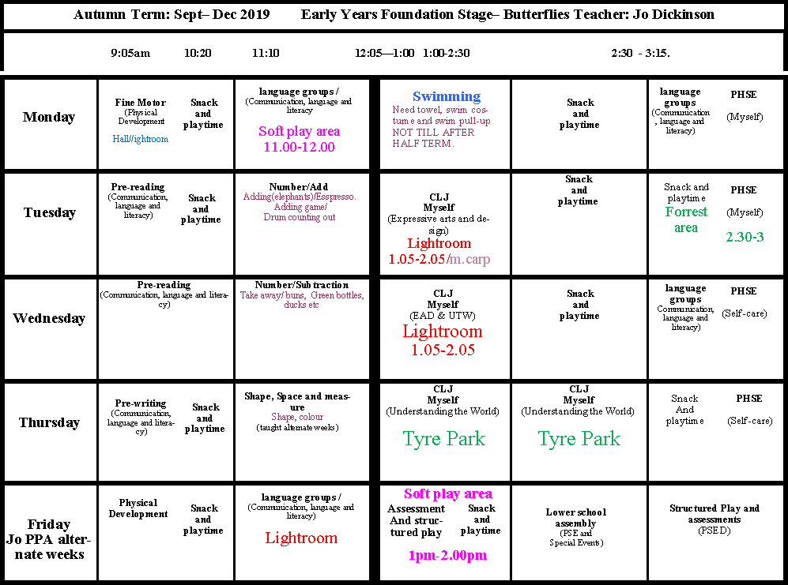
“Let’s have a look at a typical day/week.”

Slide 10
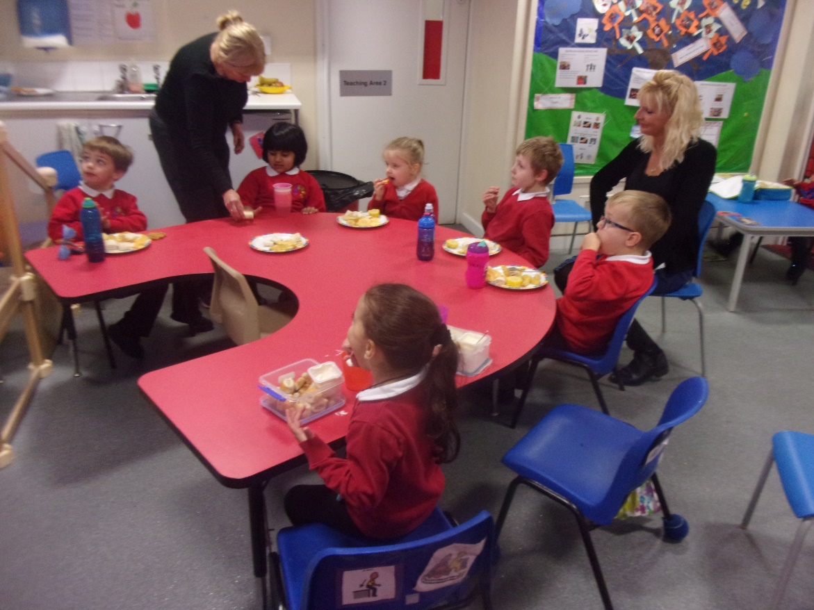
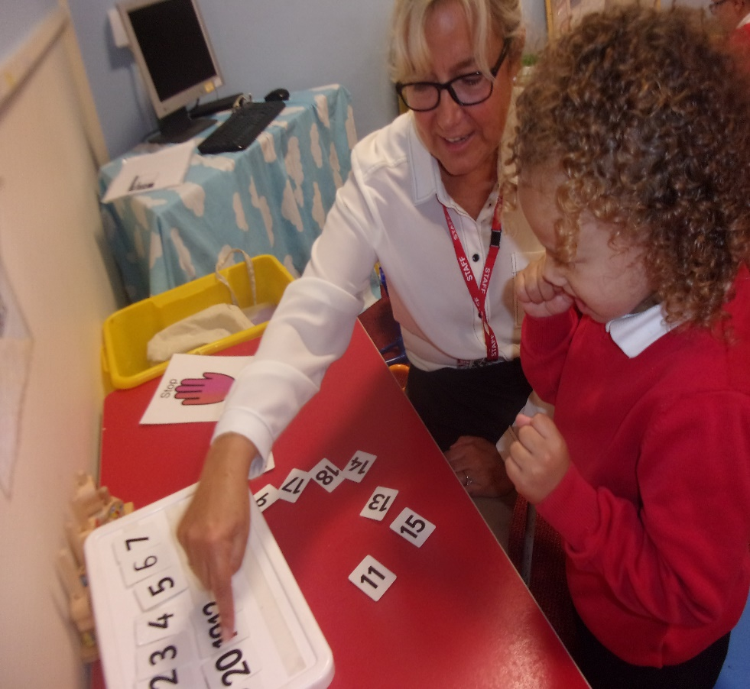
This is our group table and workstation area

Slide 11
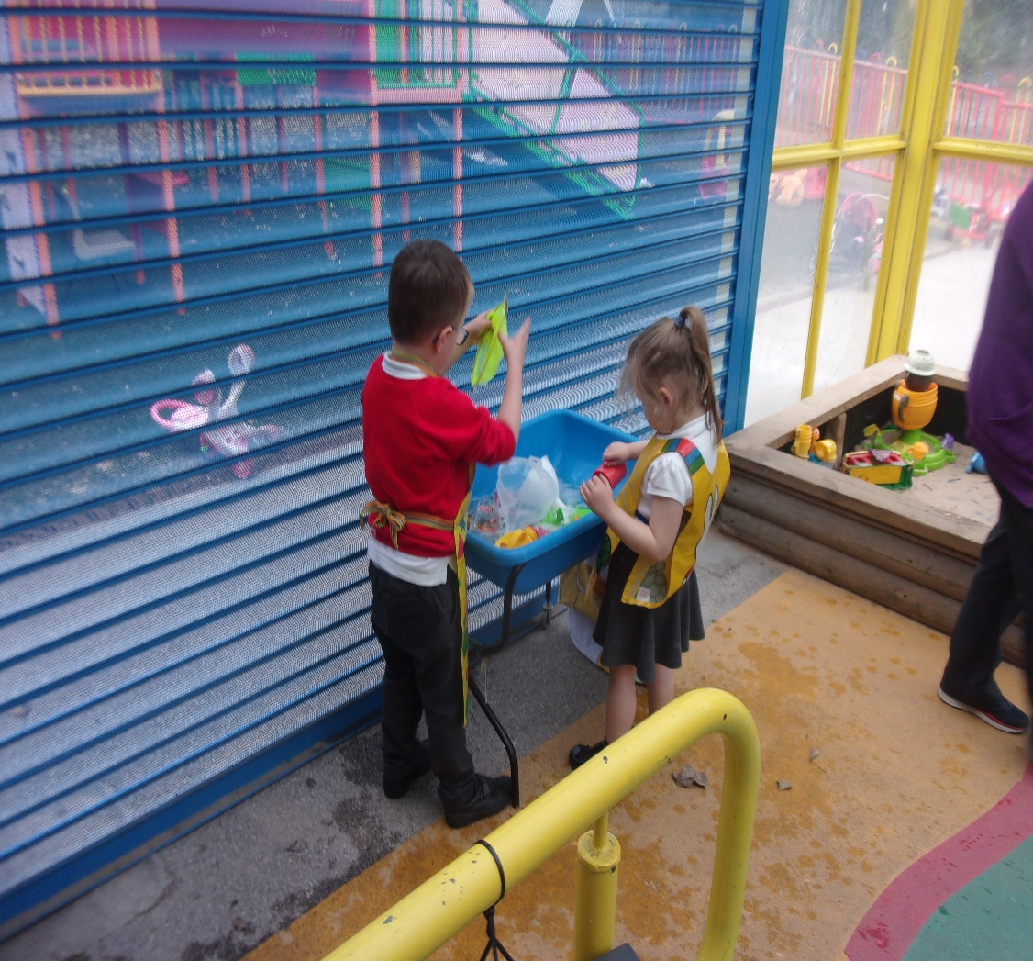
These are our free choice play areas.

Slide 12
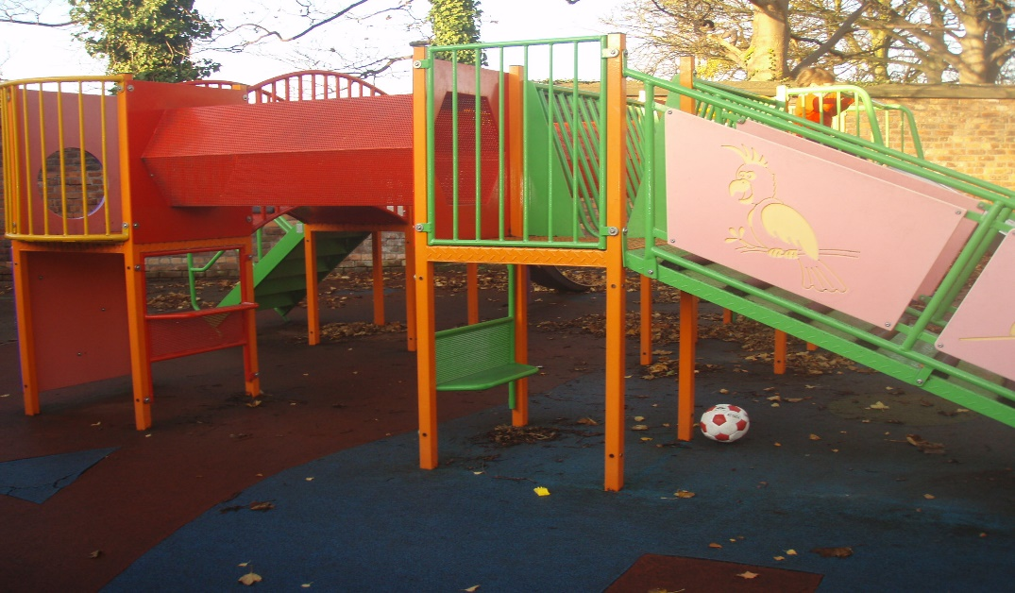
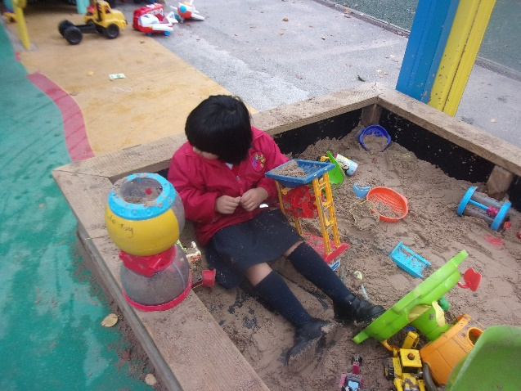
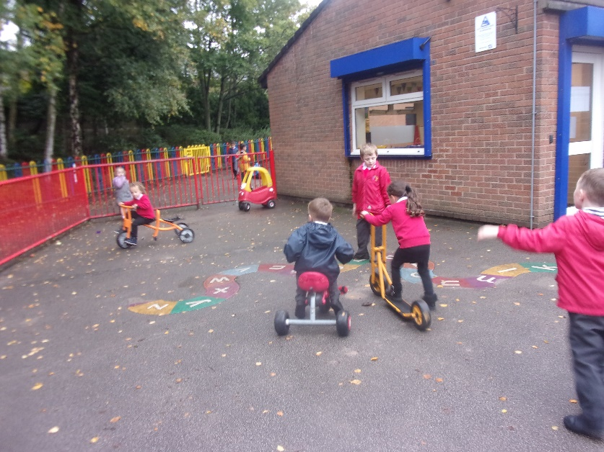
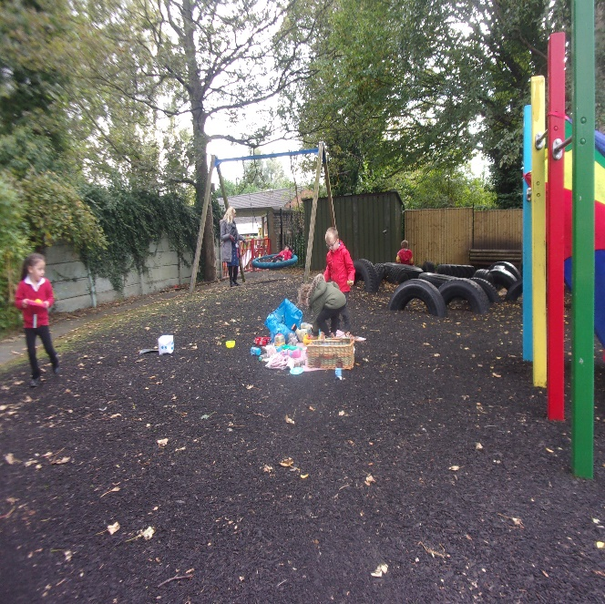
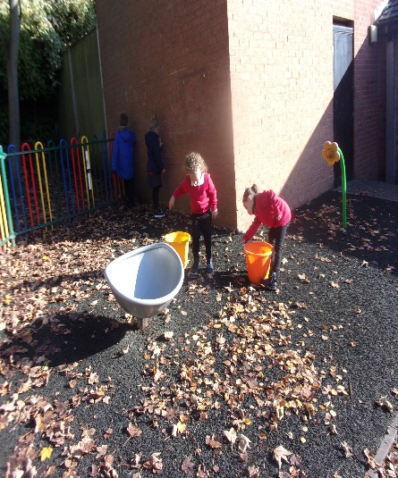
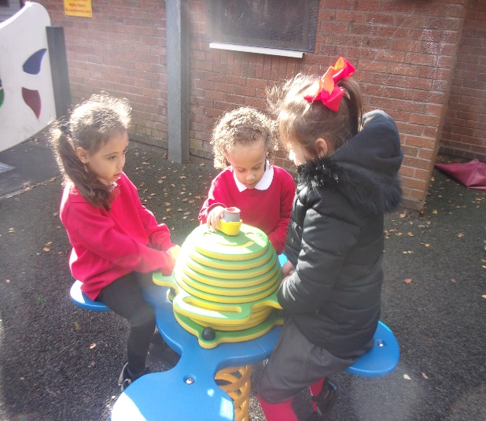
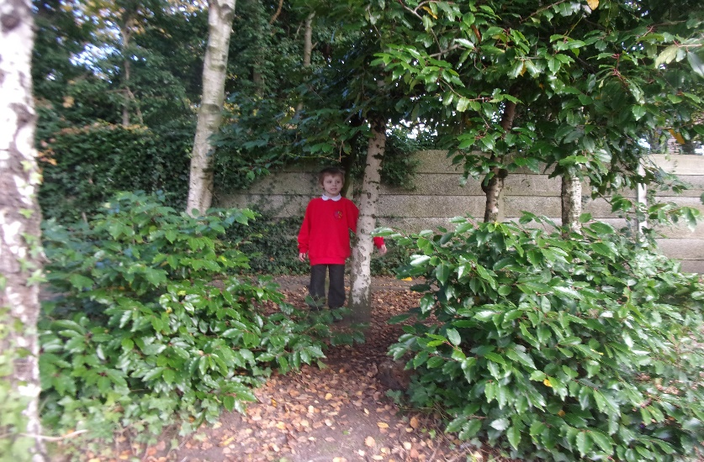
Our outdoor play areas.

Slide 13
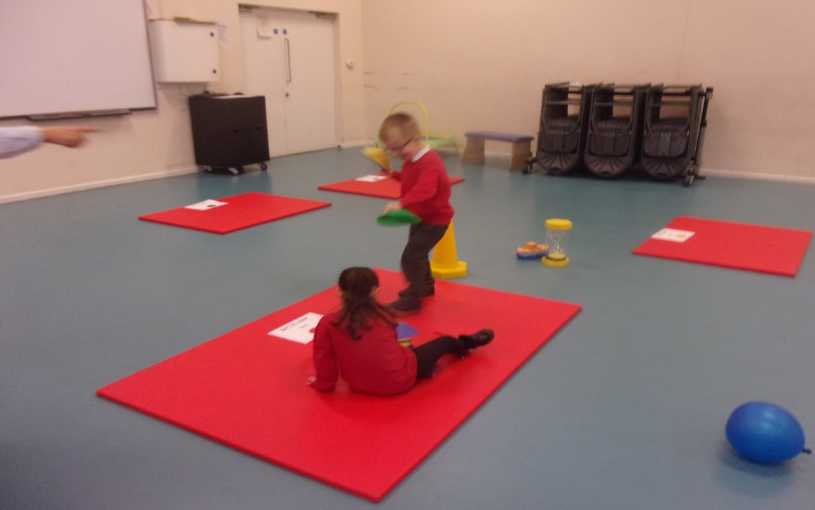
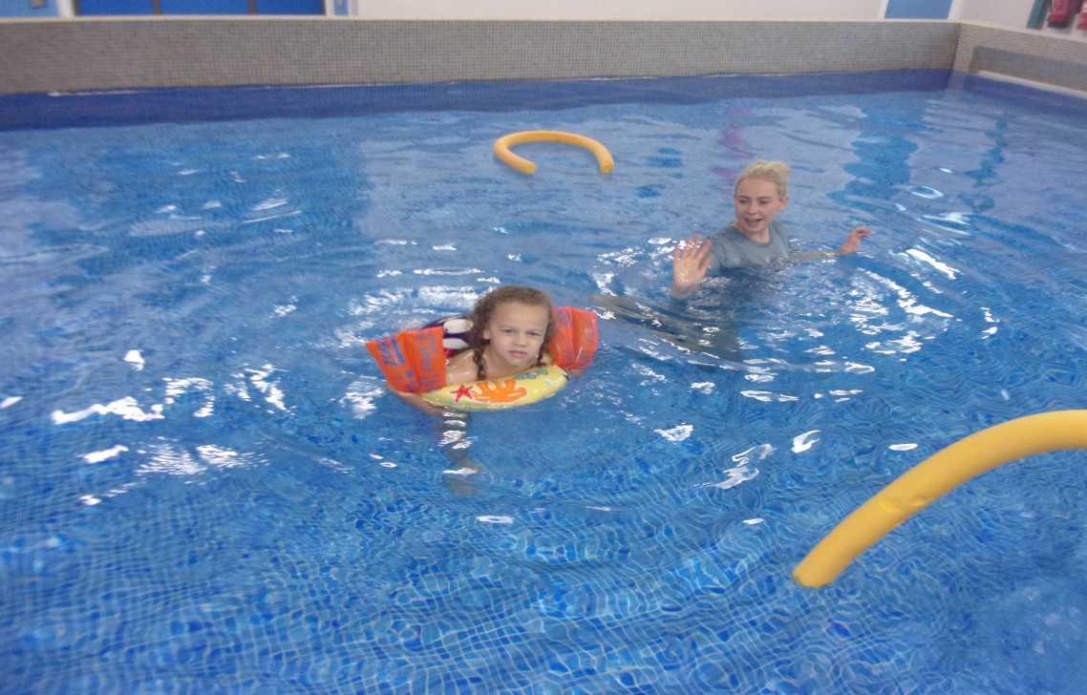
The PE/hall and pool.

