Slide 1
Welcome to Bumblebees

Slide 2
My name is Stacey, I am your new teacher

Slide 3
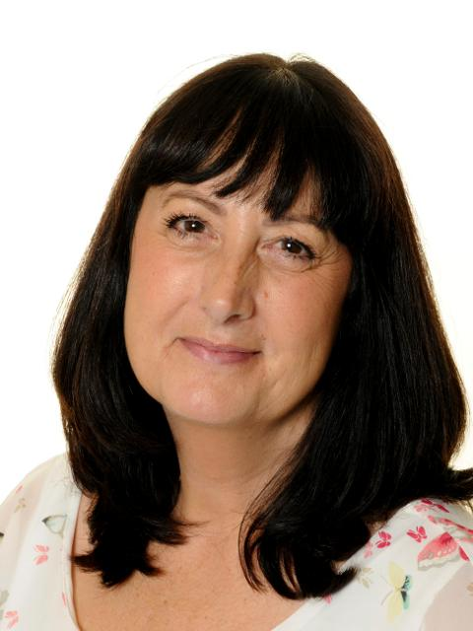
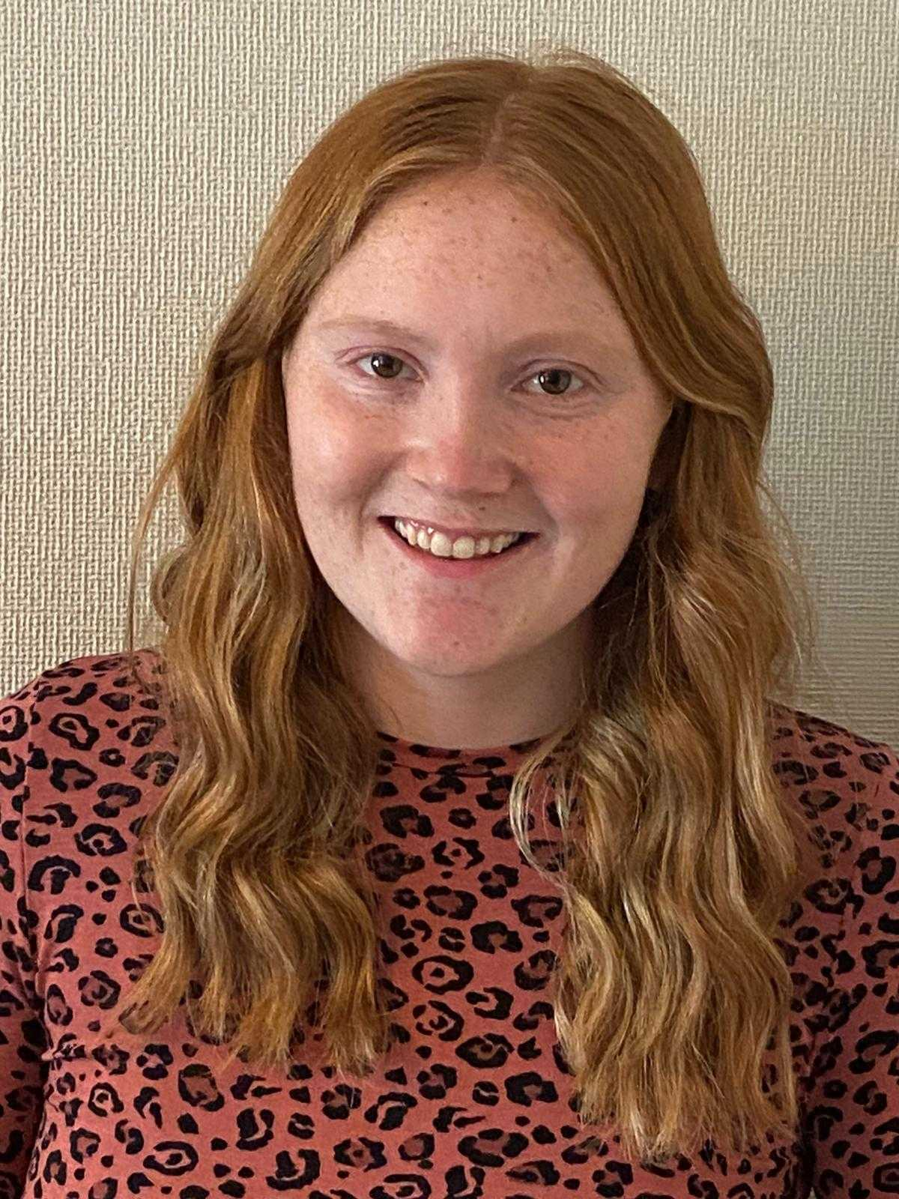
Here are your teacher assistants, we will all help you and make you feel happy and safe.
Coleen
Alice
Jessica

Slide 4
This is our classroom door, shall we see what is inside?

Slide 5
Welcome to our classroom, this is where you will learn and play.

Slide 6
We also have a sensory room and break out area for relaxing and sensory play.

Slide 7
This is our outdoor area, we have astro-turf so we can go outside come rain or shine.

Slide 8
This is the bathroom

Slide 9
We can’t wait to all be together in September!

Slide 10
What to bring in September
Spare clothes and welly boots
Continence products, wipes and nappy bags
Out first topic is learning all about ourselves and our families, please could you bring in a baby photo and photo of people who live in your home. This can be sent to my email address stclark@brookfields.halton.sch.uk
Have a lovely summer and see you in September!

